Slide 1
Probabilistic Algorithm for Testing Primality
Michael o. rabin
JOURNAL OF NUMBER THEORY 12
December 1977
Presented by: Raúl Alejandro Vargas acosta

Slide 2
Overview
Definitions
Previous work
Miller-Rabin’s time complexity
Miller-Rabin’s algorithm
Example
RSA
Q & A

Slide 3
Definitions
Prime number
Composite
Notes:
A Prime Number can be divided evenly only by 1, or itself. And it must be a whole number greater than 1.
A Composite Number is a whole number that can be divided evenly by numbers other than 1 or itself.
http://www.mathsisfun.com/definitions/composite-number.html

Slide 4

Previous work
Existing methods require for arbitrary integers n a number of steps O(n^{ε}) where ε is some fraction such as $\frac{1}{3}$ or $\frac{1}{4}$. Thus, experimental results indicate that around n = 10⁶⁵ each of these methods encounters some numbers untestable by it.

Slide 5
Miller-Rabin’s time complexity
O(c (log₂ n)²)
Where c is about 100
In practice:
O(c log₂ n)
O(3 log₂ n)

Slide 6
Miller-Rabin’s algorithm
Given n, find s so that n−1 = 2^{s} q
Pick a random a ∈{1,...,n−1}
If a ^{q} = 1 or a ^{q} = -1 then n passes (and exit).
For i = 0, ..., s−1 see if a^{(2^i) q} = −1.
If so, n passes (and exit)
or if a^{(2^i) q} = 1
If so, n is composite (and exit)
Otherwise n is composite.
https://crypto.stanford.edu/pbc/notes/numbertheory/millerrabin.html
http://homepages.math.uic.edu/~leon/mcs425-s08/handouts/Rabin-Miller.pdf
Notes:
Explain algorithm

Slide 7
Example
Given n, find s so that n−1 = 2^{s} q
Pick a random a ∈{1,...,n−1}
If a ^{q} = 1 or a ^{q} = -1 then n passes (and exit).
For i = 0, ..., s−1 see if a^{(2^i) q} = −1.
If so, n passes (and exit)
or if a^{(2^i) q} = 1
If so, n is composite (and exit)
Otherwise n is composite.
n = 104717
104716 = 2² (26179)
Notes:
Execute algorithm

Slide 8
Example
Given n, find s so that n−1 = 2^{s} q
Pick a random a ∈{1,...,n−1}
If a ^{q} = 1 or a ^{q} = -1 then n passes (and exit).
For i = 0, ..., s−1 see if a^{(2^i) q} = −1.
If so, n passes (and exit)
or if a^{(2^i) q} = 1
If so, n is composite (and exit)
Otherwise n is composite.
n = 104717, s = 2 and q = 26179
104716 = 2² (26179)

Slide 9
Example
Given n, find s so that n−1 = 2^{s} q
Pick a random a ∈{1,...,n−1}
If a ^{q} = 1 or a ^{q} = -1 then n passes (and exit).
For i = 0, ..., s−1 see if a^{(2^i) q} = −1.
If so, n passes (and exit)
or if a^{(2^i) q} = 1
If so, n is composite (and exit)
Otherwise n is composite.
n = 104717, s = 2 and q = 26179
a = 92831
a²⁶¹⁷⁹ ≡ 1 (mod n)
Conclusion: n is prime
Notes:
≡ = congruent
n is prime because it satifies 1st if (a ^{q}=1 (mod n)

Slide 10
Example
Given n, find s so that n−1 = 2^{s} q
Pick a random a ∈{1,...,n−1}
If a ^{q} = 1 or a ^{q} = -1 then n passes (and exit).
For i = 0, ..., s−1 see if a^{(2^i) q} = −1.
If so, n passes (and exit)
or if a^{(2^i) q} = 1
If so, n is composite (and exit)
Otherwise n is composite.
n = 3057601

Slide 11
Example
Given n, find s so that n−1 = 2^{s} q
Pick a random a ∈{1,...,n−1}
If a ^{q} = 1 or a ^{q} = -1 then n passes (and exit).
For i = 0, ..., s−1 see if a^{(2^i) q} = −1.
If so, n passes (and exit)
or if a^{(2^i) q} = 1
If so, n is composite (and exit)
Otherwise n is composite.
n = 3057601, s = 6 and q = 47775
3057600 = 2⁶ (47775)

Slide 12
Example
Given n, find s so that n−1 = 2^{s} q
Pick a random a ∈{1,...,n−1}
If a ^{q} = 1 or a ^{q} = -1 then n passes (and exit).
For i = 0, ..., s−1 see if a^{(2^i) q} = −1.
If so, n passes (and exit)
or if a^{(2^i) q} = 1
If so, n is composite (and exit)
Otherwise n is composite.
n = 3057601, s = 6 and q = 47775
3057600 = 2⁶ (47775)
a = 99908 (mod n)

Slide 13
Example
Given n, find s so that n−1 = 2^{s} q
Pick a random a ∈{1,...,n−1}
If a ^{q} = 1 or a ^{q} = -1 then n passes (and exit).
For i = 0, ..., s−1 see if a^{(2^i) q} = −1.
If so, n passes (and exit)
or if a^{(2^i) q} = 1
If so, n is composite (and exit)
Otherwise n is composite.
n = 3057601, s = 6 and q = 47775
3057600 = 2⁶ (47775)
a = 99908 (mod n)
a⁴⁷⁷⁷⁵ ≡ 1193206 (mod n)

Slide 14
Example
Given n, find s so that n−1 = 2^{s} q
Pick a random a ∈{1,...,n−1}
If a ^{q} = 1 or a ^{q} = -1 then n passes (and exit).
For i = 0, ..., s−1 see if a^{(2^i) q} = −1.
If so, n passes (and exit)
or if a^{(2^i) q} = 1
If so, n is composite (and exit)
Otherwise n is composite.
n = 3057601, s = 6 and q = 47775
3057600 = 2⁶ (47775)
a = 99908 (mod n)
a⁴⁷⁷⁷⁵ ≡ 1193206 (mod n)
a ²⁽⁴⁷⁷⁷⁵⁾ ≡ 2286397 (mod n)

Slide 15
Example
Given n, find s so that n−1 = 2^{s} q
Pick a random a ∈{1,...,n−1}
If a ^{q} = 1 or a ^{q} = -1 then n passes (and exit).
For i = 0, ..., s−1 see if a^{(2^i) q} = −1.
If so, n passes (and exit)
or if a^{(2^i) q} = 1
If so, n is composite (and exit)
Otherwise n is composite.
n = 3057601, s = 6 and q = 47775
3057600 = 2⁶ (47775)
a = 99908 (mod n)
a⁴⁷⁷⁷⁵ ≡ 1193206 (mod n)
a ²⁽⁴⁷⁷⁷⁵⁾ ≡ 2286397 (mod n)
a ^{(2^2) * 47775} ≡ 235899 (mod n)

Slide 16
Example
Given n, find s so that n−1 = 2^{s} q
Pick a random a ∈{1,...,n−1}
If a ^{q} = 1 or a ^{q} = -1 then n passes (and exit).
For i = 0, ..., s−1 see if a^{(2^i) q} = −1.
If so, n passes (and exit)
or if a^{(2^i) q} = 1
If so, n is composite (and exit)
Otherwise n is composite.
n = 3057601, s = 6 and q = 47775
3057600 = 2⁶ (47775)
a = 99908 (mod n)
a⁴⁷⁷⁷⁵ ≡ 1193206 (mod n)
a ²⁽⁴⁷⁷⁷⁵⁾ ≡ 2286397 (mod n)
a ^{(2^2) * 47775} ≡ 235899 (mod n)
a ^{(2^3) * 47775} ≡ 1 (mod n)
Conclusion: n is composite.
Notes:
n is composite because it satisfies last if

Slide 17
Example
Given n, find s so that n−1 = 2^{s} q
Pick a random a ∈{1,...,n−1}
If a ^{q} = 1 or a ^{q} = -1 then n passes (and exit).
For i = 0, ..., s−1 see if a^{(2^i) q} = −1.
If so, n passes (and exit)
or if a^{(2^i) q} = 1
If so, n is composite (and exit)
Otherwise n is composite.
n = 95721889

Slide 18
Example
Given n, find s so that n−1 = 2^{s} q
Pick a random a ∈{1,...,n−1}
If a ^{q} = 1 or a ^{q} = -1 then n passes (and exit).
For i = 0, ..., s−1 see if a^{(2^i) q} = −1.
If so, n passes (and exit)
or if a^{(2^i) q} = 1
If so, n is composite (and exit)
Otherwise n is composite.
n = 95721889, s = 5 and q = 2991309
95721888 = 2⁵ (2991309)

Slide 19
Example
Given n, find s so that n−1 = 2^{s} q
Pick a random a ∈{1,...,n−1}
If a ^{q} = 1 or a ^{q} = -1 then n passes (and exit).
For i = 0, ..., s−1 see if a^{(2^i) q} = −1.
If so, n passes (and exit)
or if a^{(2^i) q} = 1
If so, n is composite (and exit)
Otherwise n is composite.
n = 95721889, s = 5 and q = 2991309
a = 21906436

Slide 20
Example
Given n, find s so that n−1 = 2^{s} q
Pick a random a ∈{1,...,n−1}
If a ^{q} = 1 or a ^{q} = -1 then n passes (and exit).
For i = 0, ..., s−1 see if a^{(2^i) q} = −1.
If so, n passes (and exit)
or if a^{(2^i) q} = 1
If so, n is composite (and exit)
Otherwise n is composite.
n = 95721889, s = 5 and q = 2991309
a = 21906436
a²⁹⁹¹³⁰⁹ ≡ 373440 (mod n)

Slide 21
Example
Given n, find s so that n−1 = 2^{s} q
Pick a random a ∈{1,...,n−1}
If a ^{q} = 1 or a ^{q} = -1 then n passes (and exit).
For i = 0, ..., s−1 see if a^{(2^i) q} = −1.
If so, n passes (and exit)
or if a^{(2^i) q} = 1
If so, n is composite (and exit)
Otherwise n is composite.
n = 95721889, s = 5 and q = 2991309
a = 21906436
a²⁹⁹¹³⁰⁹ ≡ 373440 (mod n)
a ²⁽²⁹⁹¹³⁰⁹⁾ ≡ 86363216 (mod n)

Slide 22
Example
Given n, find s so that n−1 = 2^{s} q
Pick a random a ∈{1,...,n−1}
If a ^{q} = 1 or a ^{q} = -1 then n passes (and exit).
For i = 0, ..., s−1 see if a^{(2^i) q} = −1.
If so, n passes (and exit)
or if a^{(2^i) q} = 1
If so, n is composite (and exit)
Otherwise n is composite.
n = 95721889, s = 5 and q = 2991309
a = 21906436
a²⁹⁹¹³⁰⁹ ≡ 373440 (mod n)
a ²⁽²⁹⁹¹³⁰⁹⁾ ≡ 86363216 (mod n)
a ^{(2^2)} ^{* 2991309} ≡ 93382930 (mod n)

Slide 23
Example
Given n, find s so that n−1 = 2^{s} q
Pick a random a ∈{1,...,n−1}
If a ^{q} = 1 or a ^{q} = -1 then n passes (and exit).
For i = 0, ..., s−1 see if a^{(2^i) q} = −1.
If so, n passes (and exit)
or if a^{(2^i) q} = 1
If so, n is composite (and exit)
Otherwise n is composite.
n = 95721889, s = 5 and q = 2991309
a = 21906436
a²⁹⁹¹³⁰⁹ ≡ 373440 (mod n)
a ²⁽²⁹⁹¹³⁰⁹⁾ ≡ 86363216 (mod n)
a ^{(2^2)} ^{* 2991309} ≡ 93382930 (mod n)
a ^{(2^3)*2991309} ≡ 31803553 (mod n)

Slide 24
Example
Given n, find s so that n−1 = 2^{s} q
Pick a random a ∈{1,...,n−1}
If a ^{q} = 1 or a ^{q} = -1 then n passes (and exit).
For i = 0, ..., s−1 see if a^{(2^i) q} = −1.
If so, n passes (and exit)
or if a^{(2^i) q} = 1
If so, n is composite (and exit)
Otherwise n is composite.
n = 95721889, s = 5 and q = 2991309
a = 21906436
a²⁹⁹¹³⁰⁹ ≡ 373440 (mod n)
a ²⁽²⁹⁹¹³⁰⁹⁾ ≡ 86363216 (mod n)
a ^{(2^2)} ^{* 2991309} ≡ 93382930 (mod n)
a ^{(2^3)*2991309} ≡ 31803553 (mod n)
a ^{(2^4)*2991309} ≡ 63099174 (mod n)

Slide 25
Example
Given n, find s so that n−1 = 2^{s} q
Pick a random a ∈{1,...,n−1}
If a ^{q} = 1 or a ^{q} = -1 then n passes (and exit).
For i = 0, ..., s−1 see if a^{(2^i) q} = −1.
If so, n passes (and exit)
or if a^{(2^i) q} = 1
If so, n is composite (and exit)
Otherwise n is composite.
n = 95721889, s = 5 and q = 2991309
a = 21906436
a²⁹⁹¹³⁰⁹ ≡ 373440 (mod n)
a ²⁽²⁹⁹¹³⁰⁹⁾ ≡ 86363216 (mod n)
a ^{(2^2)} ^{* 2991309} ≡ 93382930 (mod n)
a ^{(2^3)*2991309} ≡ 31803553 (mod n)
a ^{(2^4)*2991309} ≡ 63099174 (mod n)
Conclusion: n is composite.
Notes:
n is composite because the the for loop didn’t find a 1 (mod n)

Slide 26
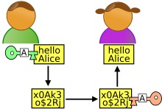
RSA
Notes:
Explain two type of encryption algorithms, symmetric and asymmetric
Asymmetric need public key and secret key.

Slide 27
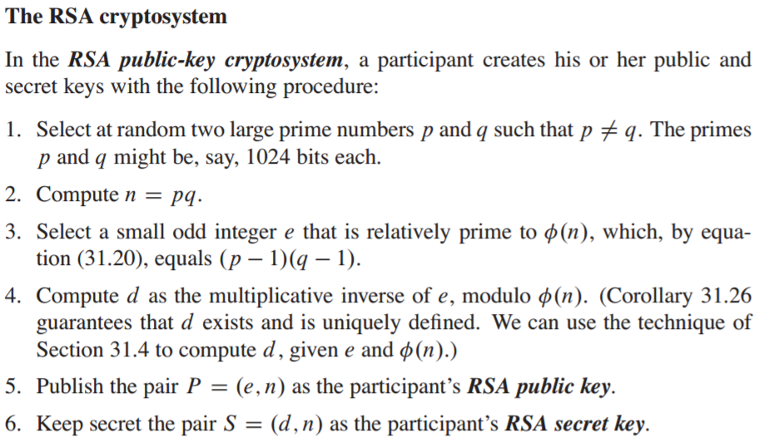
RSA
Notes:
RSA is an asymmetric algorithm and it generates a public and secret key using two large primer numbers
The have to be large enough so modern computers can’t figure them out using n (which is public)
In this type of algorithms it is necessary to identify large primer numbers, Rabin’s algorithm is needed

Slide 28
Q & A

Slide 29
References
Rabin, M. O. (1980). Probabilistic algorithm for testing primality. Journal of Number Theory, 12(1), 128-138. doi:http://dx.doi.org/10.1016/0022-314X(80)90084-0
https://crypto.stanford.edu/pbc/notes/numbertheory/millerrabin.html
http://homepages.math.uic.edu/~leon/mcs425-s08/handouts/Rabin-Miller.pdf
Karakra, A., & Alsadeh, A. (2016). A-RSA: Augmented RSA. 2016 SAI Computing Conference (SAI), 1016-1023. doi:10.1109/SAI.2016.7556103
Cormen, T. H. (2009). Introduction to Algorithms: MIT Press.

